Slide 1

MEMBERS
Shabana M. (180071601035)
Taslima parveen S.Z. (180071601047)
BUILD A REAL-TIME TRANSLATION APP THAT CAN LISTEN AND SPEAK
2nd Review 19.03.22

Slide 2
SUPERVISOR : Dr. SHARMILA SANKAR
DESIGNATION: Professor
BUILD A REAL-TIME TRANSLATION APP THAT CAN LISTEN AND SPEAK
2nd Review 19.03.22

Slide 3
DOMAIN
Natural Language Processing(NLP)
BUILD A REAL-TIME TRANSLATION APP THAT CAN LISTEN AND SPEAK
2nd Review 19.03.22

Slide 4
TITLE OF THE PROJECT
Build a real-time translation app that can listen and speak.
BUILD A REAL-TIME TRANSLATION APP THAT CAN LISTEN AND SPEAK
2nd Review 19.03.22

Slide 5
ABSTRACT
The aim is to automate the application to overcome language barrier.
The application recognizes speech in one language to another user defined language.
Includes speech recognition, language translation and speech synthesis.
The application accepts text written and converts it into the language needed by recognizing the text present in the image or captured using camera.
BUILD A REAL-TIME TRANSLATION APP THAT CAN LISTEN AND SPEAK
2nd Review 19.03.22

Slide 6
A language will be chosen from a list of options in which the text is to be entered.
Also the language in which the text is to be translated is also selected from the list of options.
After selecting the languages, the translate button will be clicked to translate.
BUILD A REAL-TIME TRANSLATION APP THAT CAN LISTEN AND SPEAK
2nd Review 19.03.22

Slide 7
LITERATURE SURVEY
S. NO | Title and Name of the Author | Name of the Journal and Year | Algorithm/ Method Used | Advantage
1. | Unsupervised Neural Machine Translation. K. Cho, M. Artetxe, G. Labaka & E. Agirre. | Published as a conference paper at ICLR 2018 | Unsupervised Learning Method | The model can profit from small parallel corpora.
BUILD A REAL-TIME TRANSLATION APP THAT CAN LISTEN AND SPEAK
2nd Review 19.03.22

Slide 8
S. NO. | Title and Name of the Author | Name of the Journal and Year | Algorithm/ Method Used | Advantage
2. | Deep Learning Technique for Detecting NSCLC. Bhargav Hegde, Dayananda P, Mahesh Hegde, Chetan C. | International Journal of Recent Technology and Engineering (IJRTE), Volume-8 Issue-3, September 2019, pp. 7841-7843 | Deep Learning. | Translates the speech by automation recognizer having all three mentioned configurations.
BUILD A REAL-TIME TRANSLATION APP THAT CAN LISTEN AND SPEAK
2nd Review 19.03.22

Slide 9
S. NO. | Title and Name of the Author | Name of the Journal and Year | Algorithm/ Method Used | Advantage
3. | Real-Time Translation of Indian Sign Language. E. Abraham, A. Nayak and A. Iqbal. | 2019 Global Conference for Advancement in Technology (GCAT) | LSTM Algorithm | A placed sensor of glove with sensor of flex help to design the orientation of hand and following actions.
BUILD A REAL-TIME TRANSLATION APP THAT CAN LISTEN AND SPEAK
2nd Review 19.03.22

Slide 10
S. NO. | Title and Name of the Author | Name of the Journal and Year | Algorithm/ Method Used | Advantage
4. | Speech to Text Translation enabling Multilingualism. Shahana bano, Gorsa Lakshmi Niharika. | Multilingualism”2020 IEEE International Conference for Innovation in Technology (INOCON). | NLP | It converts the speech data given by the user as an input into the text format in its desired language.
BUILD A REAL-TIME TRANSLATION APP THAT CAN LISTEN AND SPEAK
2nd Review 19.03.22

Slide 11
S. NO. | Title and Name of the Author | Name of the Journal and Year | Algorithm/ Method Used | Advantage
5. | Speech to text and text to speech recognition systems-A review. Ayushi Trivedi, Navya Pant. | IOSR Journal of Computer Engineering (IOSR-JCE)e-ISSN: 2278-0661, p-ISSN: 2278-8727, Volume 20, Issue 2, Ver. I (Mar.- Apr. 2018). | NLP | Effective communication between two parties without hindrances, many applications have come to picture, which acts as a mediator and help in effectively carrying messages in form of text, or speech signals over miles of networks.
BUILD A REAL-TIME TRANSLATION APP THAT CAN LISTEN AND SPEAK
2nd Review 19.03.22

Slide 12
S. NO. | Title and Name of the Author | Name of the Journal and Year | Algorithm/ Method Used | Advantage
6. | Machine Translation (MT) Techniques for Indian Languages. S.Anbukkarasi, Dr. Varadha ganapathy | Journal of Recent Technology and Engineering (IJRTE) ISSN: 2277-3878, Volume-8 Issue-2S4, July 2019. | Machine Learning | Machine Translation draws the idea of linguistics, computer science, artificial intelligence, sociology, psychology etc.
BUILD A REAL-TIME TRANSLATION APP THAT CAN LISTEN AND SPEAK
2nd Review 19.03.22

Slide 13
S. NO. | Title and Name of the Author | Name of the Journal and Year | Algorithm/ Method Used | Advantage
7. | Language Identification for Multilingual Sentiment Examination. Deepali D. Londhe, Aruna Kumari, Emmanuel M | International Journal of Recent Technology and Engineering (IJRTE)ISSN: 2277-3878, Volume-8, Issue-2S11, September 2019. | Semantic Analysis. | Sentiment analysis can be conducted using videos, image, text, where text sentiment analysis is most popular form because of freely available contents in the form of blogs, reviews, comments etc.
BUILD A REAL-TIME TRANSLATION APP THAT CAN LISTEN AND SPEAK
2nd Review 19.03.22

Slide 14
S. NO. | Title and Name of the Author | Name of the Journal and Year | Algorithm/ Method Used | Advantage
8. | Noun Identification for Tamil Language using Morphophonemic Rules. M. Mercy Evangeline, K. Shyamala. | International Journal of Recent Technology and Engineering (IJRTE)ISSN: 2277-3878, Volume-8 Issue-4, November 2019. | Speech Tagging, NIMR. | A Rule based suffix stripping approach has been adopted for this implementation. Explore the traditional way of categorizing words in Tamil language, avoiding the influence of English grammars.
BUILD A REAL-TIME TRANSLATION APP THAT CAN LISTEN AND SPEAK
2nd Review 19.03.22

Slide 15
S. NO. | Title and Name of the Author | Name of the Journal and Year | Algorithm/ Method Used | Advantage
9. | Marathi Text Analysis using Unsupervised Learning and Word Cloud. Prafulla B. Bafna, Jatinder kumar, R. Saini. | International Journal of Engineering and Advanced Technology (IJEAT)ISSN: 2249-8958 (Online), Volume-9 Issue-3, February 2020. | RNN. | Marathi corpus has been mostly exploited by the researchers for exploring stemming, single-document summarization and classifier design on Marathi corpus.
BUILD A REAL-TIME TRANSLATION APP THAT CAN LISTEN AND SPEAK
2nd Review 19.03.22

Slide 16
S. NO. | Title and Name of the Author | Name of the Journal and Year | Algorithm/ Method Used | Advantage
10. | Tamil Handwritten Character Recognition Using Artificial Neural Network. Ms. G. Thilagavathi, Ms. G. Lavanya, Dr. N.K. Karthikeyan | International journal of scientific & technology research volume 8, issue 12, december 2019 issn 2277-8616. | RNN. | This system uses are made up of sigmoid neurons. Previous implementation of such conversion systems has shown accuracy over 90%. It can be used in Banking Sectors, Answer Script Evaluation Systems for Subjective Answer Evaluation.
BUILD A REAL-TIME TRANSLATION APP THAT CAN LISTEN AND SPEAK
2nd Review 19.03.22

Slide 17
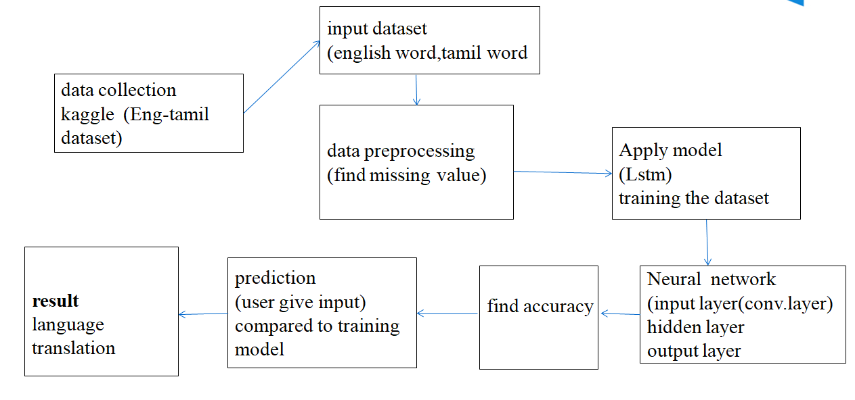
ARCHITECTURE DIAGRAM
BUILD A REAL-TIME TRANSLATION APP THAT CAN LISTEN AND SPEAK
2nd Review 19.03.22

Slide 18
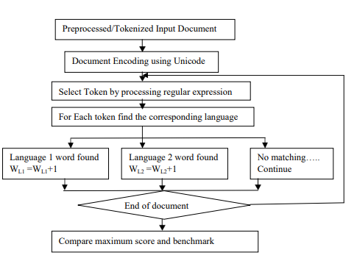
DATA FLOW DIAGRAM
BUILD A REAL-TIME TRANSLATION APP THAT CAN LISTEN AND SPEAK
2nd Review 19.03.22

Slide 19
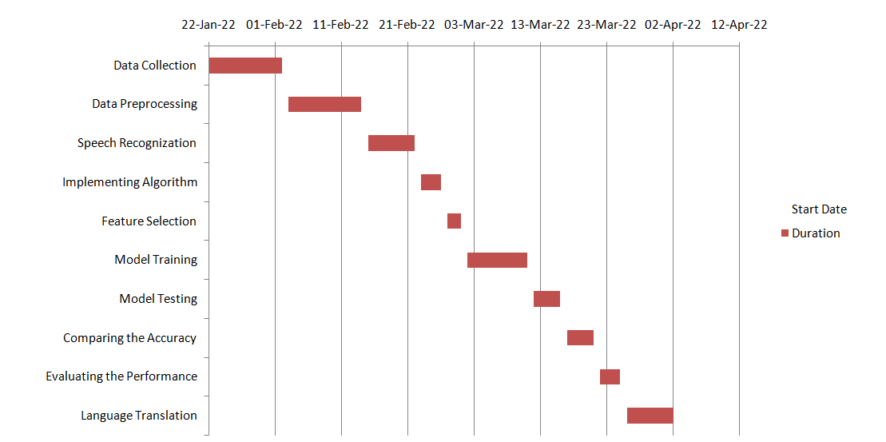
GANTT CHART
BUILD A REAL-TIME TRANSLATION APP THAT CAN LISTEN AND SPEAK
2nd Review 19.03.22

Slide 20
MODULES
Data Preprocessing
Voice Recognition
Speech Synthesis
Language Translation
BUILD A REAL-TIME TRANSLATION APP THAT CAN LISTEN AND SPEAK
2nd Review 19.03.22

Slide 21
Data Pre-processing
Pre-processing refers to the modification applied to our data before feeding it to the algorithm. Data Pre-processing is a technique, which converts the raw data into a clean data set. In other words, whenever the data is gathered from different sources it is collected in raw format which is not practical for the analysis.
Voice Recognition
Speech recognition is, of course, speech. Speech must be converted from physical sound to an electrical signal with a microphone, and then to digital data with an analog-to-digital converter. Once digitized, several models can be used to transcribe the audio to text.
BUILD A REAL-TIME TRANSLATION APP THAT CAN LISTEN AND SPEAK
2nd Review 19.03.22

Slide 22
Speech Synthesis
Speech synthesis is the computer-generated simulation of human speech. It is used to translate written information into aural information where it is more convenient, especially for mobile applications such as voice-enabled e-mail and unified messaging.
Language Translation
In Text translation we take text as input and convert it into another language. The base language is English. The text is split into words and then it is search in the dictionary and the corresponding matched text/word from the dictionary is displayed.
BUILD A REAL-TIME TRANSLATION APP THAT CAN LISTEN AND SPEAK
2nd Review 19.03.22

Slide 23
MODULES TO BE COMPLETED
Data prediction
The given language to be predicted and translated into any required language.
User Interface
A platform to connect the user and the system.
BUILD A REAL-TIME TRANSLATION APP THAT CAN LISTEN AND SPEAK
2nd Review 19.03.22

Slide 24
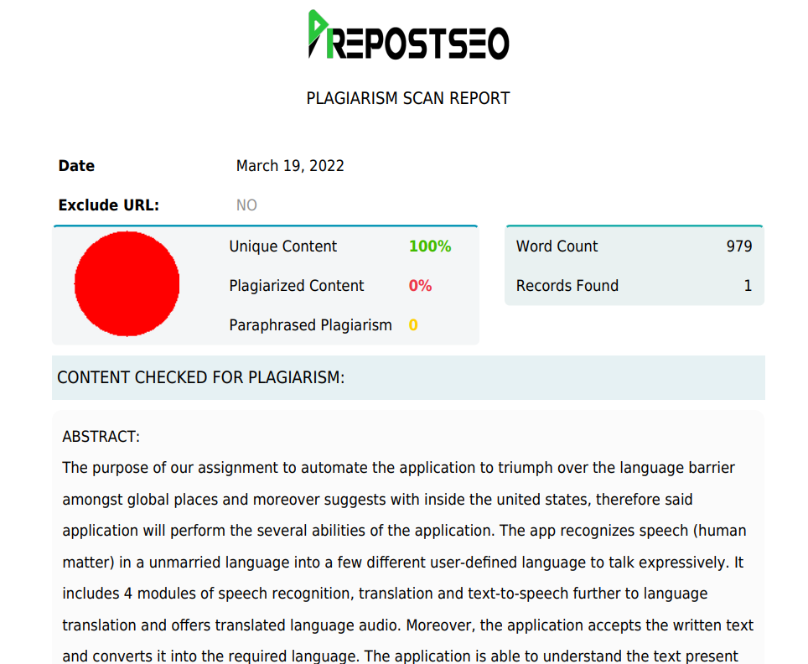
PLAGIARISM REPORT
BUILD A REAL-TIME TRANSLATION APP THAT CAN LISTEN AND SPEAK
2nd Review 19.03.22

Slide 25
THANK YOU
BUILD A REAL-TIME TRANSLATION APP THAT CAN LISTEN AND SPEAK
2nd Review 19.03.22

